Slide 1

AMCAT Data Analysis

Slide 2
About me
I’m Bhanu, currently pursuing my BTech in Computer Science and Engineering.
Why Data Science?
Data Science plays a major role in decision making.
Dealing with real time data and generating the insights from them are crucial in data science.
Behind them data science including statistics, mathematics, programming and many advance technologies like Artificial Intelligence, etc.
Profile URLs:-
LinkedIn - https://www.linkedin.com/in/bhanuindla/
GitHub - https://github.com/Bhanuindla

Slide 3
Agenda
Objective of the Project
Data set Description
Univariate Analysis
Bivariate Analysis
Key Business Question
Conclusion
Interesting Conclusions and Research Questions

Slide 4
Objective of the Project
The primary goal of this project is to:
Give detailed data description of the dataset
Perform Univariate Analysis
Perform Bivariate Analysis
-By Considering Salary as a target variable.

Slide 5
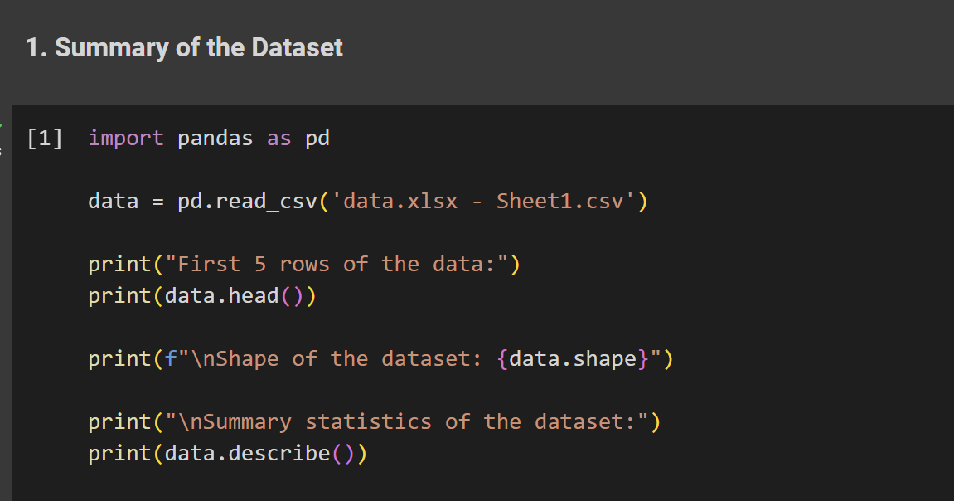
Data set Description

Slide 6
Data set Description
Shape of the Dataset:
Rows: 3,998
Columns: 39
Summary Statistics of Salary column:
Mean: 468720.44
Min: 10000
Max: 1100000

Slide 7
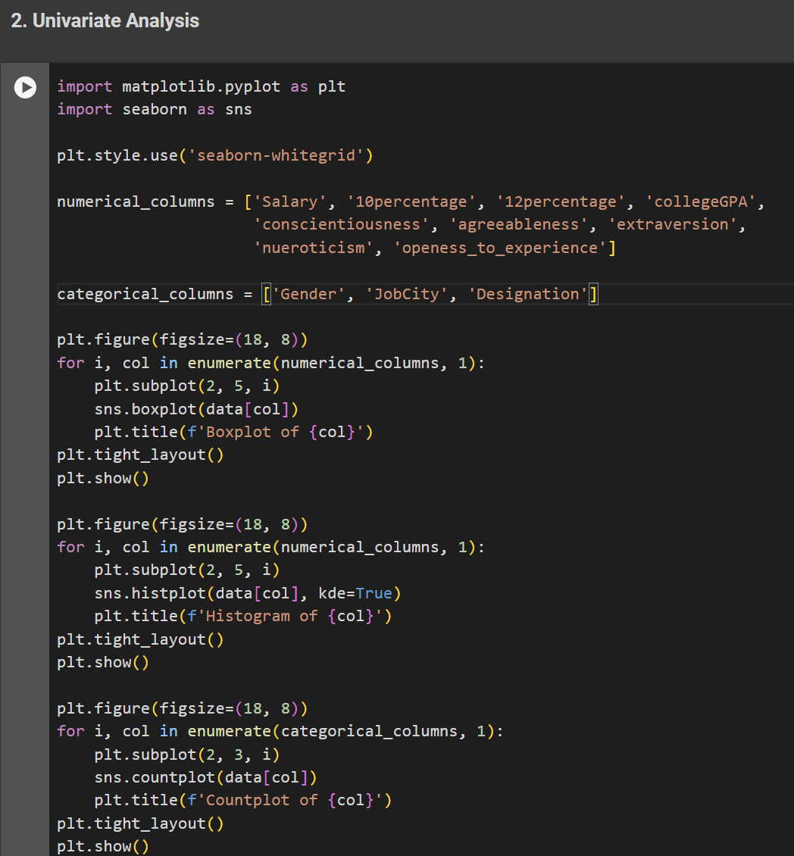
Univariate Analysis
1. Finding Outliers in Numerical
Columns
2. Probability and Frequency
Distribution of Numerical Columns
3. Frequency Distribution of
Categorical Variables

Slide 8
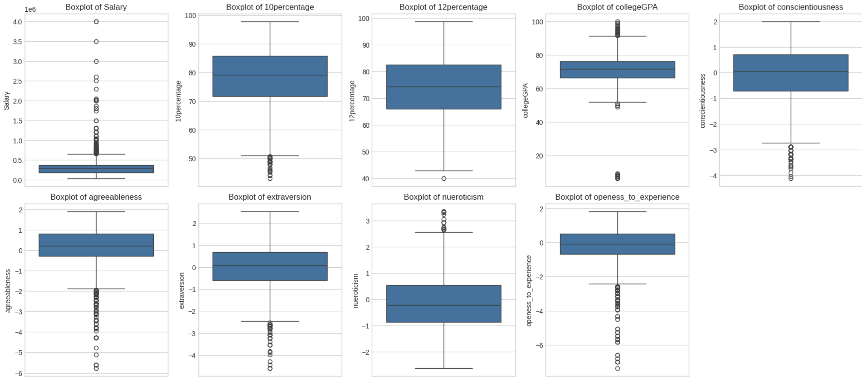
Univariate Analysis
1. Boxplots for each numerical column
-Outliers can be detected using boxplots, which highlight points lying far from the interquartile range

Slide 9
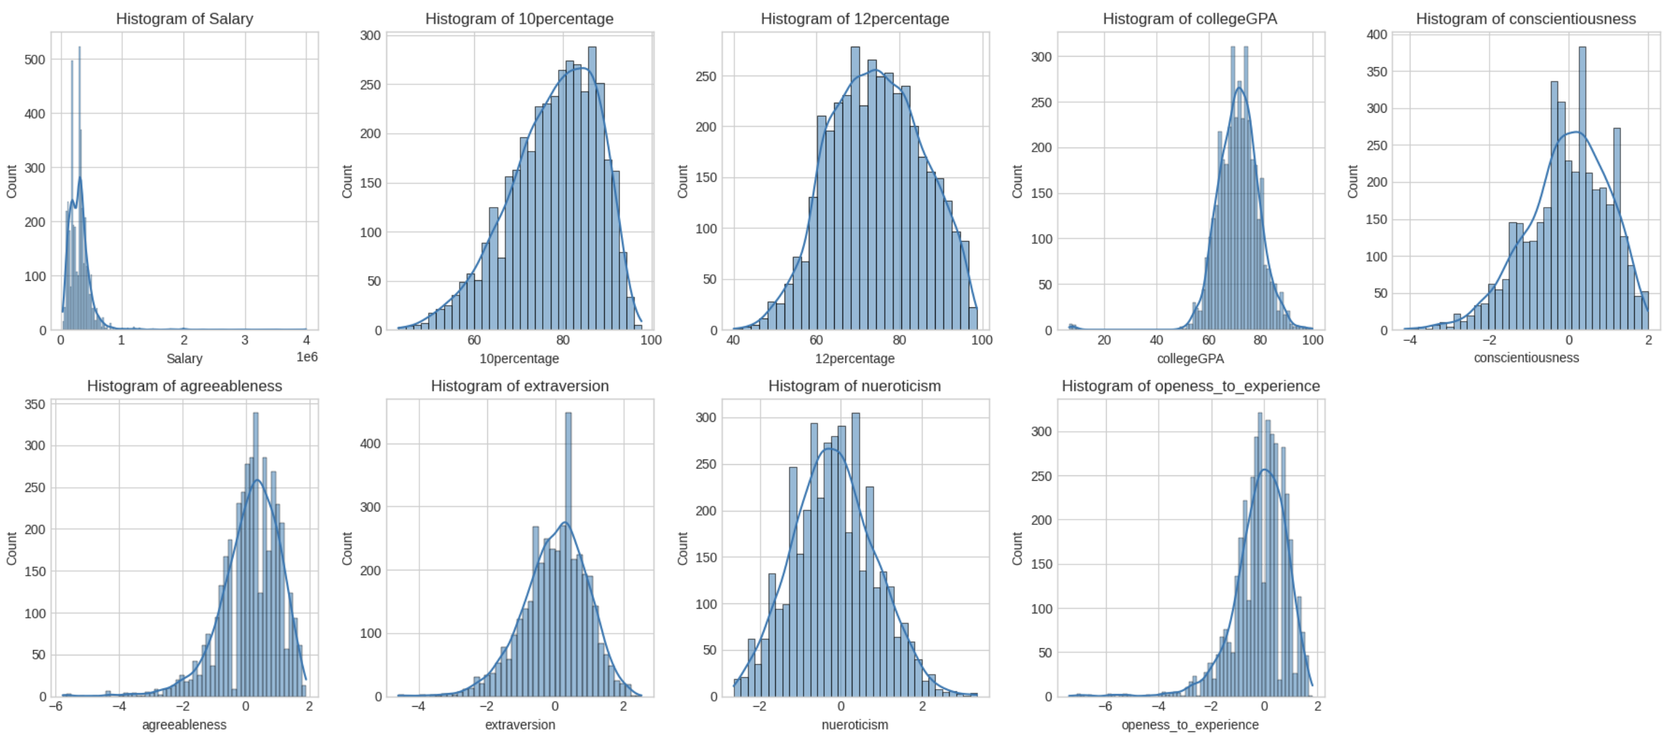
Univariate Analysis
2. probability and frequency distribution of each numerical column
-Histograms to visualize the frequency distribution
-Probability Density Functions to analyze continuous numerical data.

Slide 10
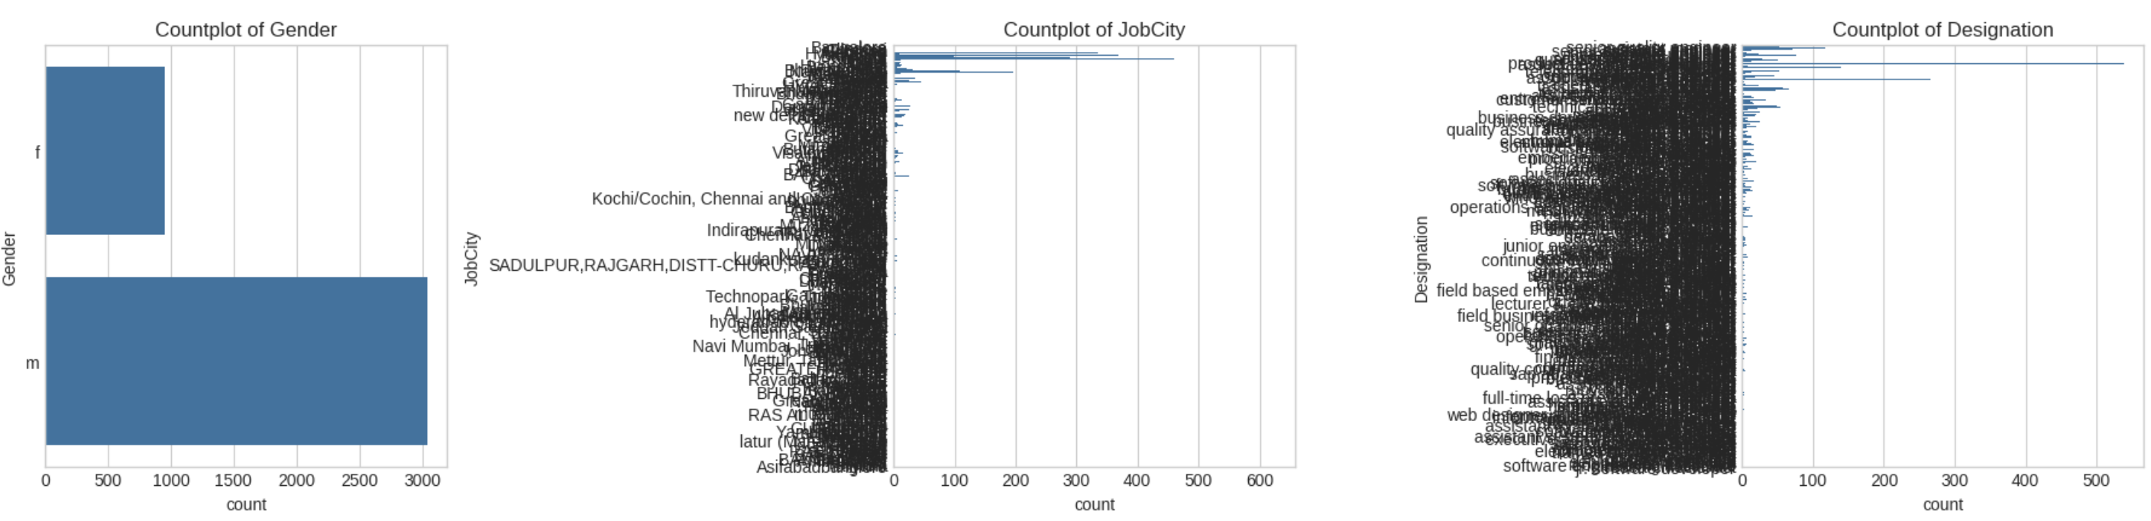
Univariate Analysis
3. Frequency distribution of each categorical Variable/Column
-Count plots to visualize the distribution of categories

Slide 11
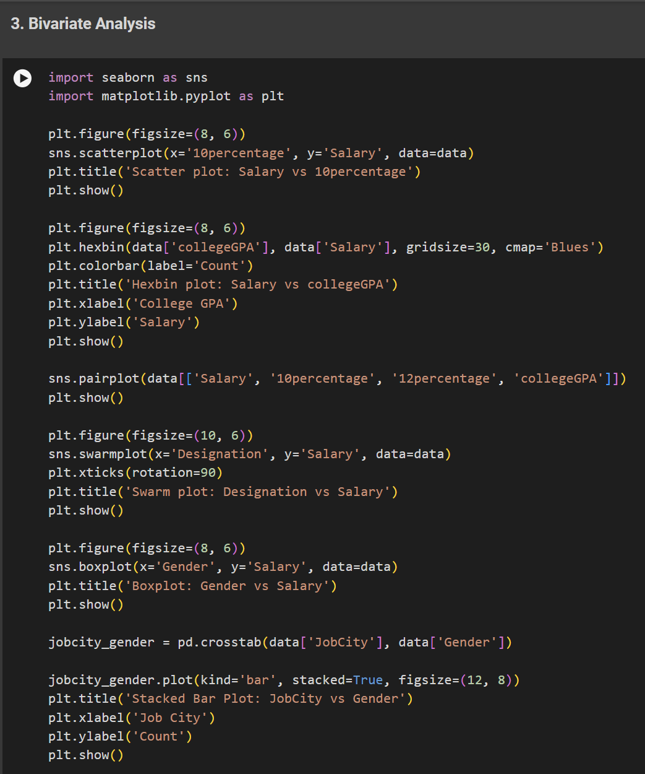
Bivariate Analysis
1. Numerical vs. Numerical Variables
using scatter plots, hexbin plots, and pair plots.
2. Categorical vs. Numerical Variables
using swarmplots, boxplots, and barplots.
3. Categorical vs. Categorical Variables
using stacked bar plots.

Slide 12
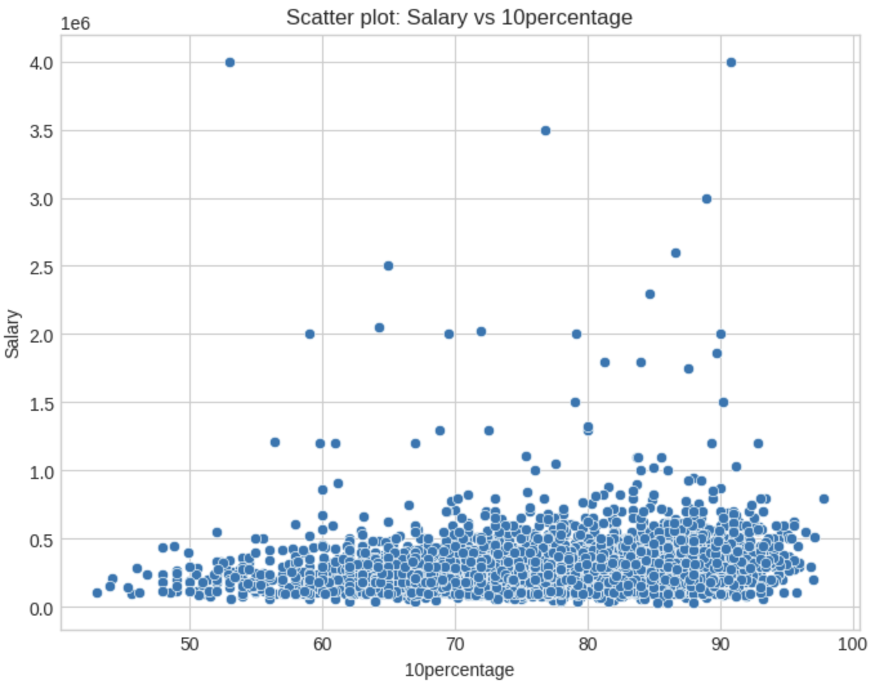
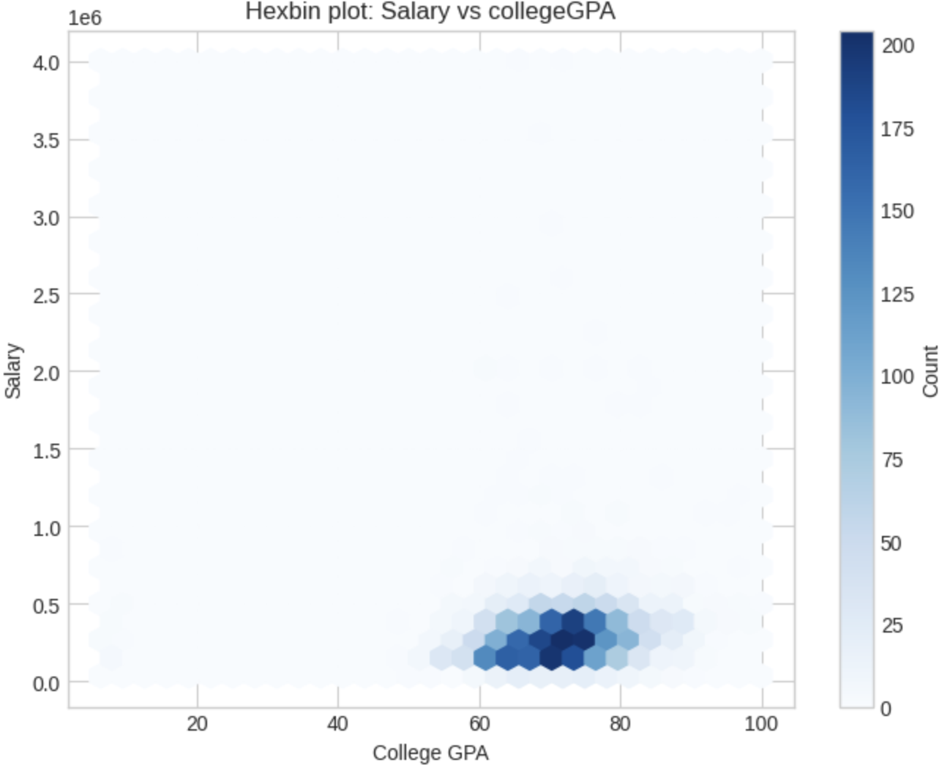
Bivariate Analysis 1. Numerical vs Numerical
1. Scatter plot for Numerical Columns
2. Hexbin plot for Numerical Columns

Slide 13
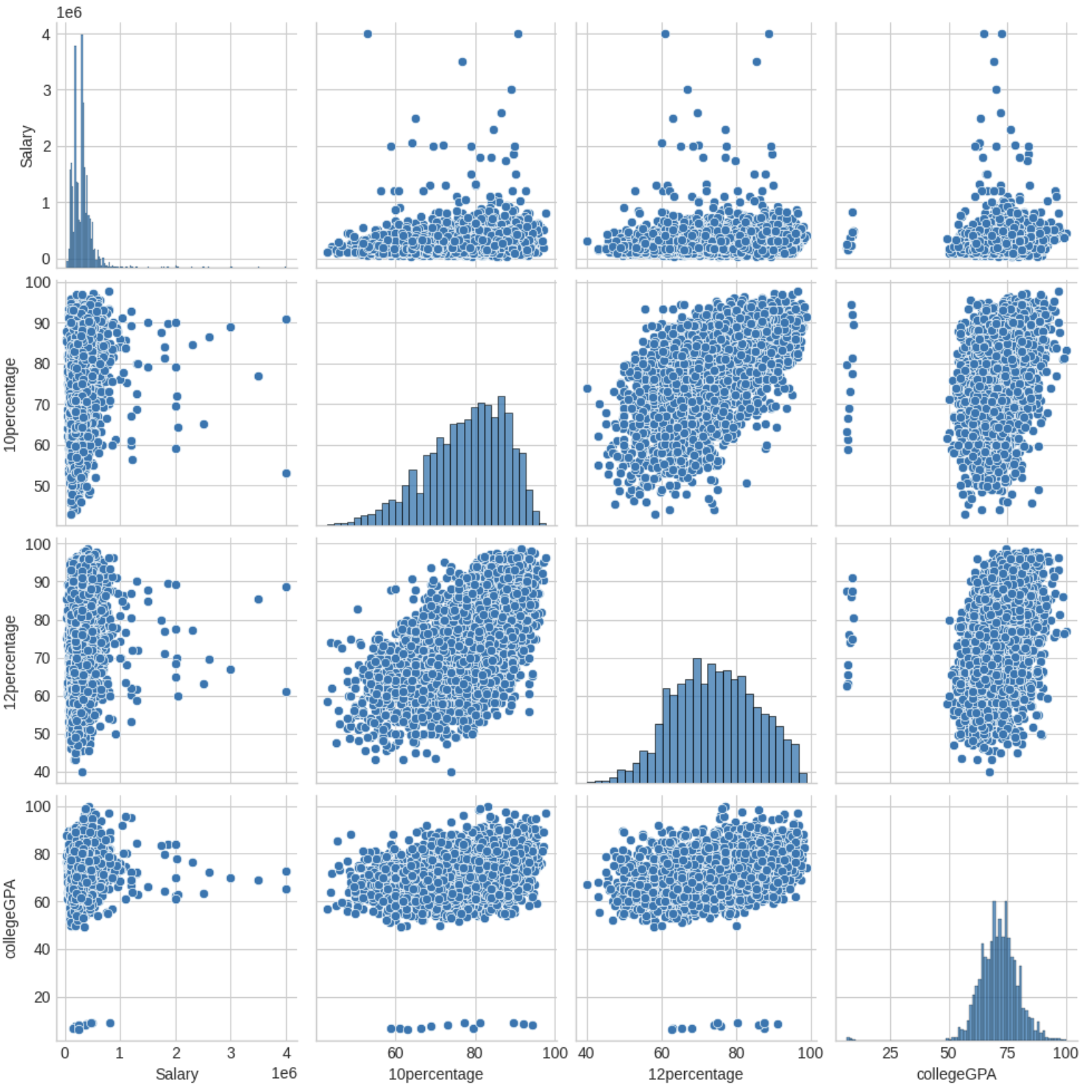
Bivariate Analysis
3. Pairplot for Numerical Columns

Slide 14
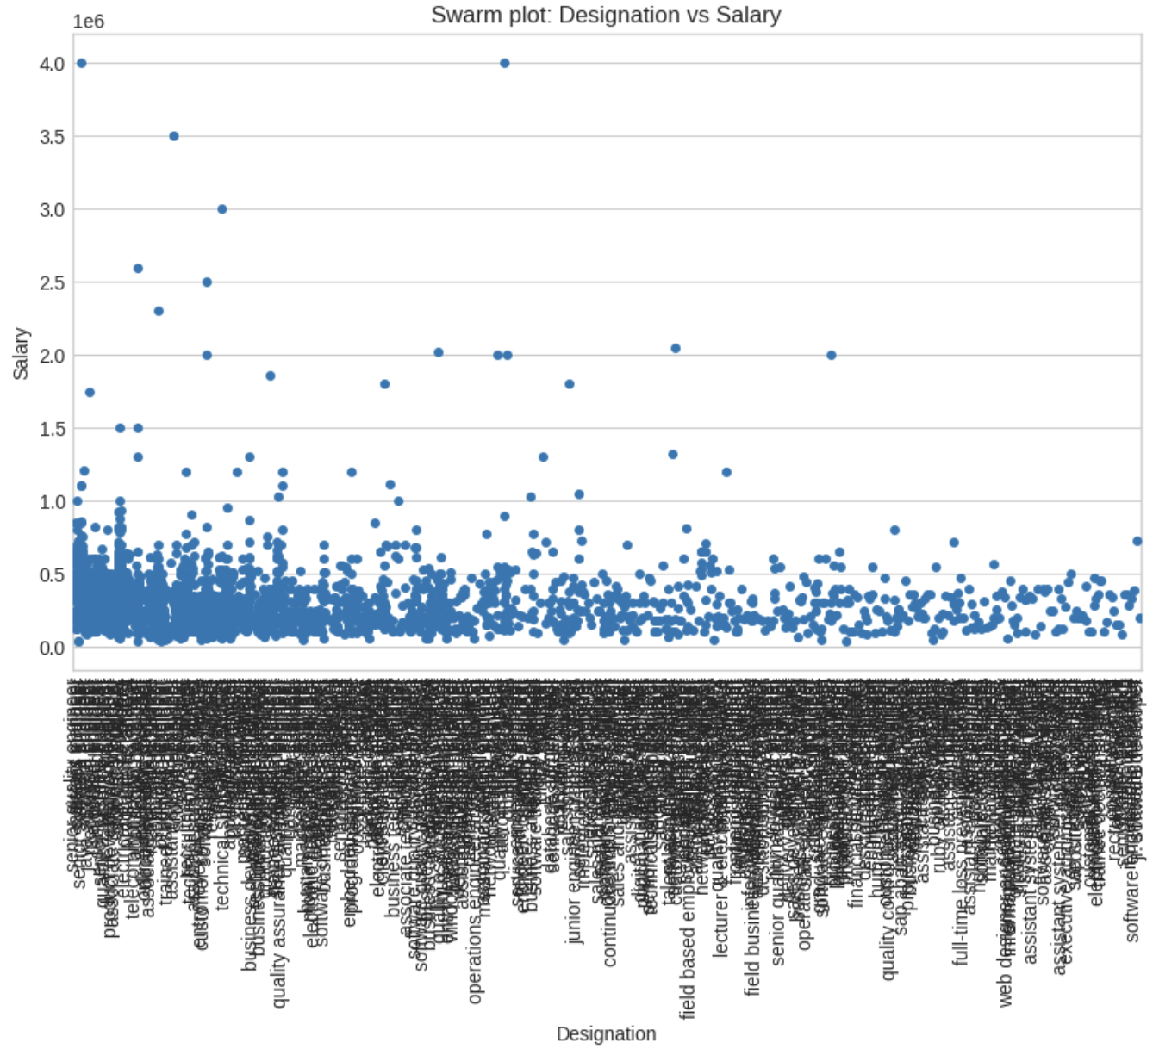
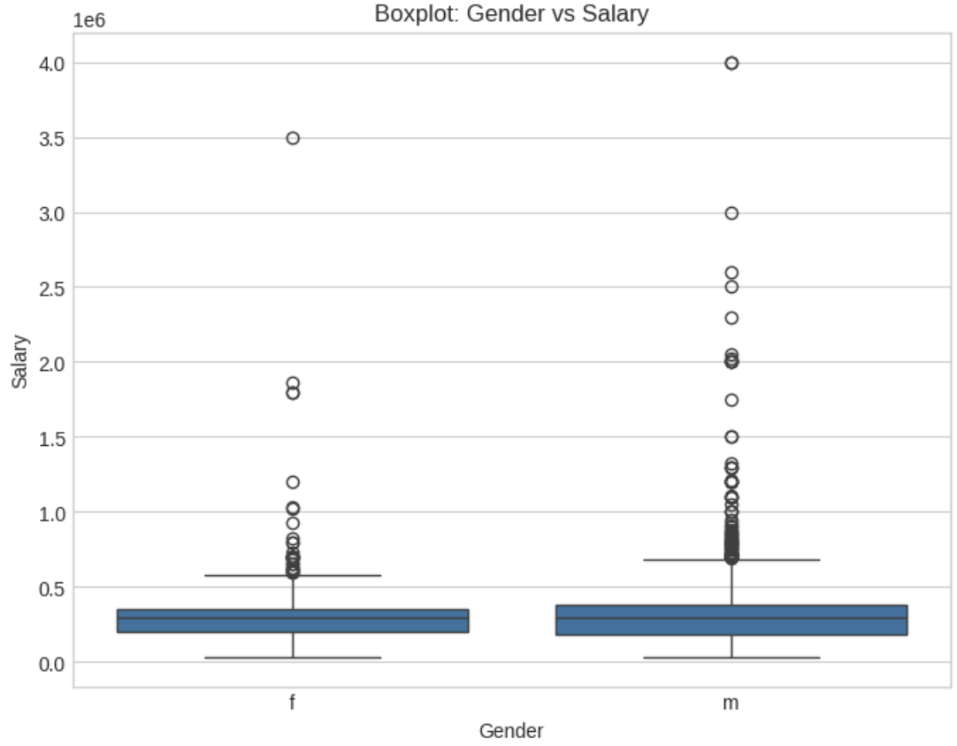
Bivariate Analysis
2. Categorical vs Numerical
- Swarm plot for Designation and Salary - Boxplot for Gender and Salary

Slide 15
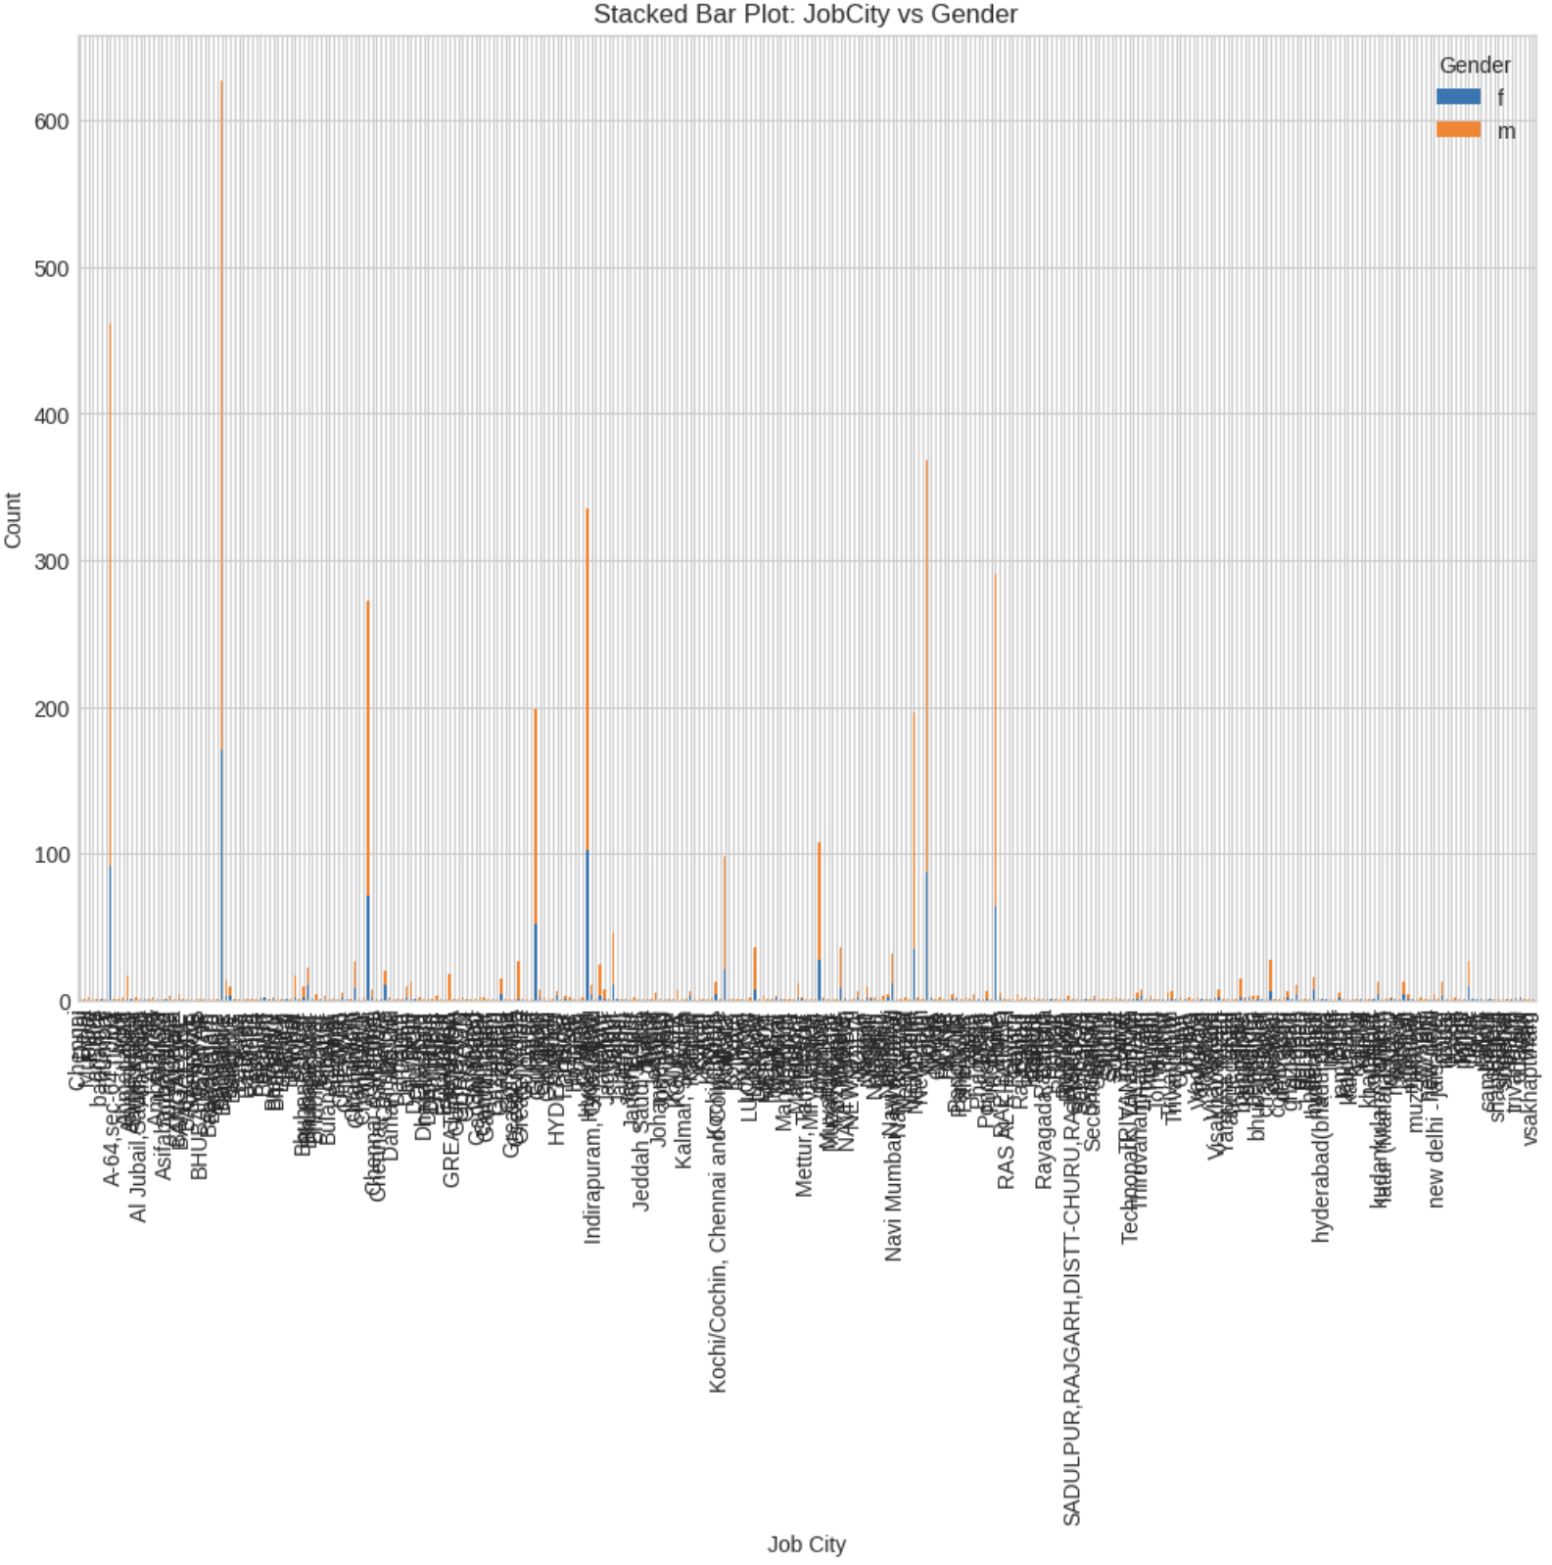
Bivariate Analysis
3. Categorical vs Categorical

Slide 16
Key Business Question
Times of India article dated Jan 18, 2019 states that “After doing your Computer Science Engineering if you take up jobs as a Programming Analyst, Software Engineer, Hardware Engineer and Associate Engineer you can earn up to 2.5-3 lakhs as a fresh graduate.”
Mean Salary of fresh graduates: nan
Median Salary of fresh graduates: nan
The salary claim of 2.5-3 lakhs is not supported by the data.

Slide 17
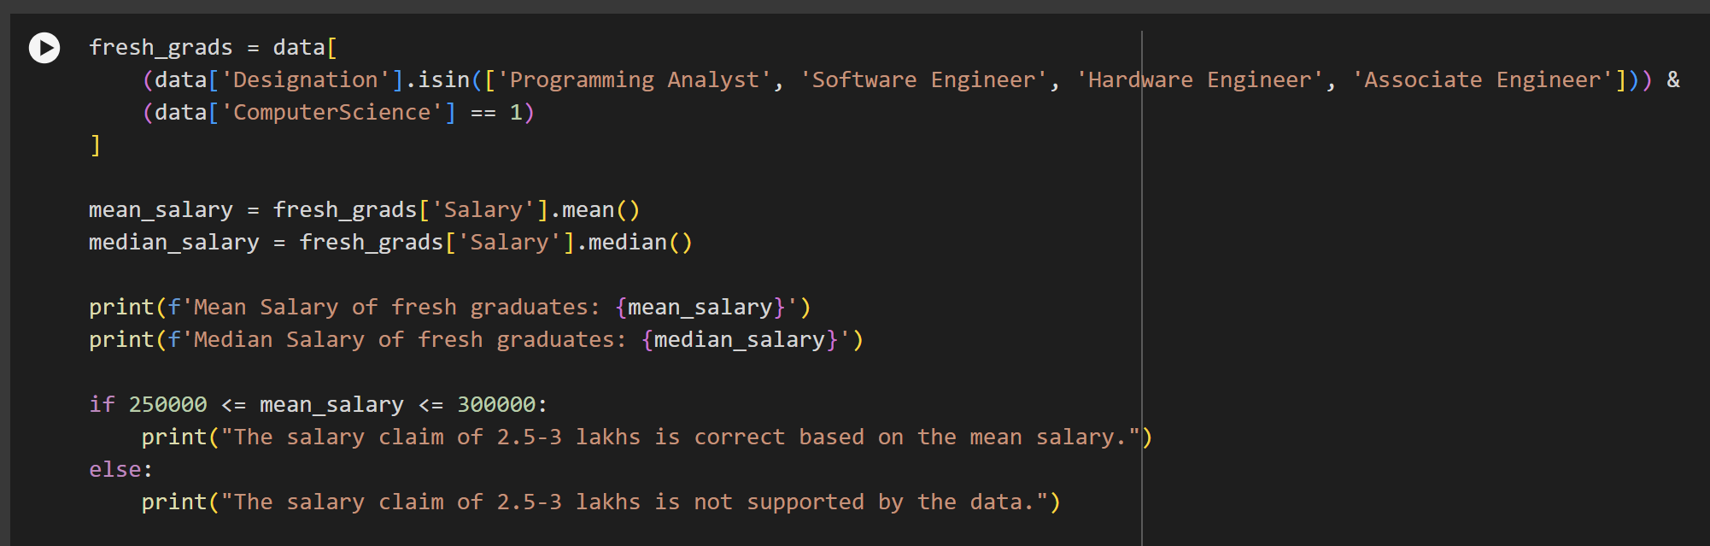
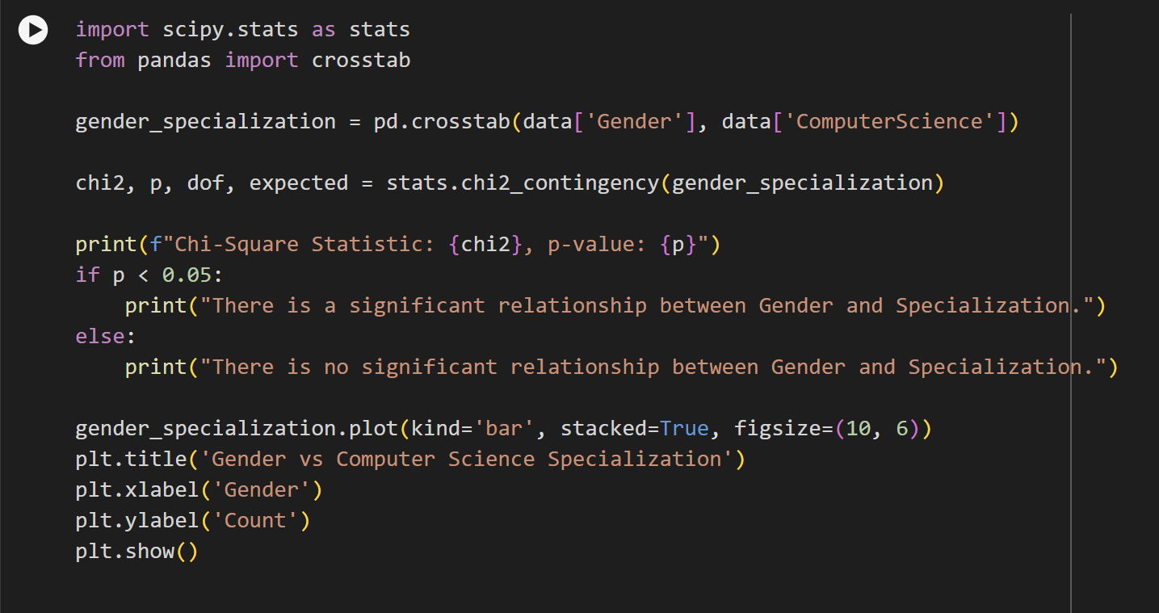
Key Business Question

Slide 18
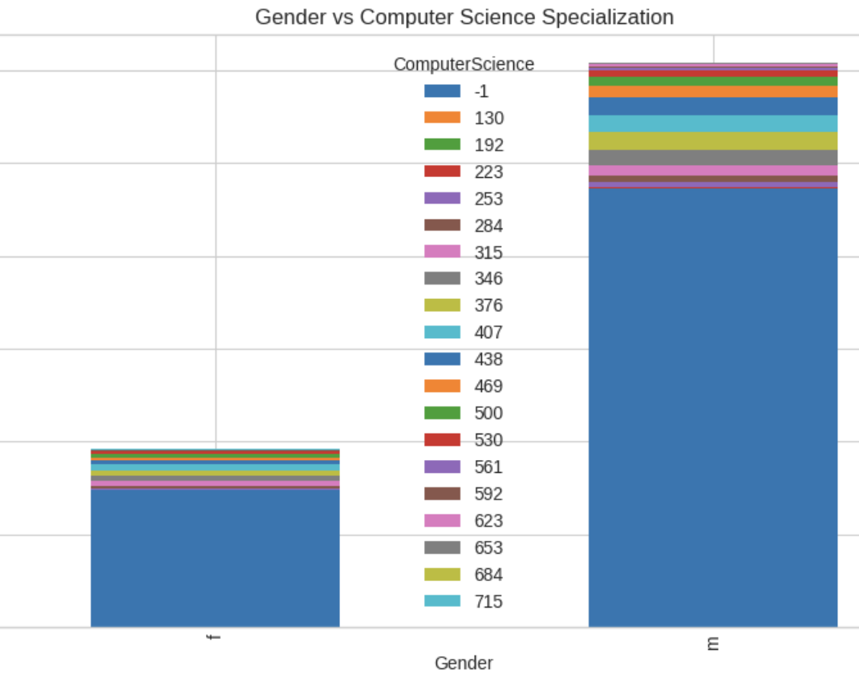
Key Business Question
2. Is there a relationship between gender and specialization? (i.e. Does the preference of Specialization depend on the Gender?)
Chi-Square Statistic: 12.620977117911053
p-value: 0.8573966356381522
There is no significant relationship between Gender and Specialization.

Slide 19
Conclusion
From the above analysis we can conclude the following:-
Outliers were identified in several numerical columns, especially in salary distribution. High salaries were seen in senior-level positions, while junior positions and fresh graduates had comparatively lower salaries.
Most employees earn between 2 to 5 lakhs, with a few outliers earning above 10 lakhs.
The distributions of high school and college grades show most individuals scoring between 70%-90%.
There is a weak positive correlation between GPA and Salary, as seen in the scatter and hexbin plots.
There is no significant relationship between Gender and Specialization.

Slide 20
Interesting Conclusions and Research Questions
Does Personality Influence Salary?
Is there a relationship between the type of city (JobCity) and Salary?
How does the employee's college GPA influence their job title and salary progression?
Does Gender Affect Promotion Rates or Job Titles?

Slide 21

THANK YOU

